Slide 1
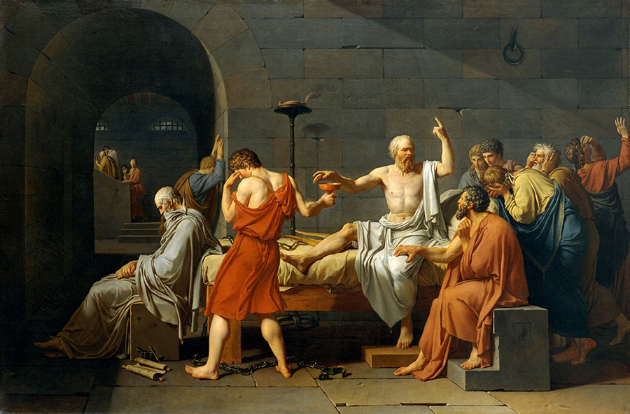
The Death of Socrates
Reporting Team
Group 2:董自经 王岳 杨文莉 林小词 周正宜

Slide 2

1
Act
Socrates was making speech in the market as usual......

Slide 3
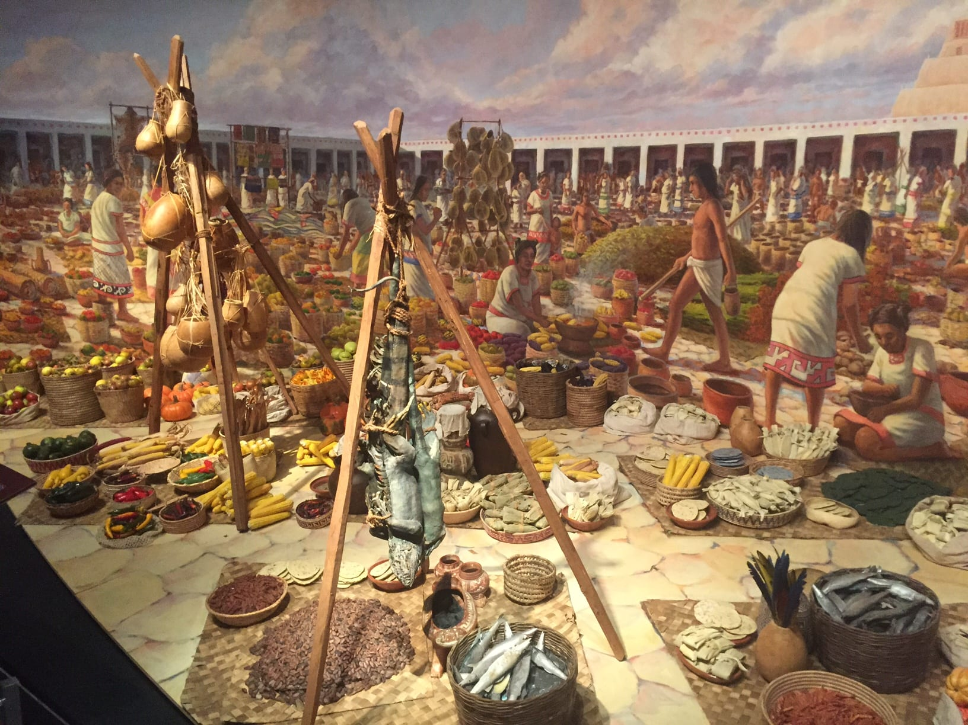


Slide 5
2
Act
Being tried in court......

Slide 6
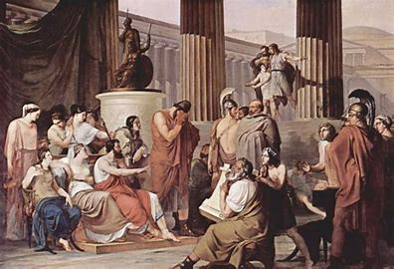

Slide 7
The simplest and noblest way to deal with the blame is not to destroy the person who blames you, but to improve yourself!!!

Slide 8
After the death sentence, the execution was postponed for 30 days.
During the 30 days, Socrates, as usual, visited his friends to discuss philosophical issues，just like usual.

Slide 9
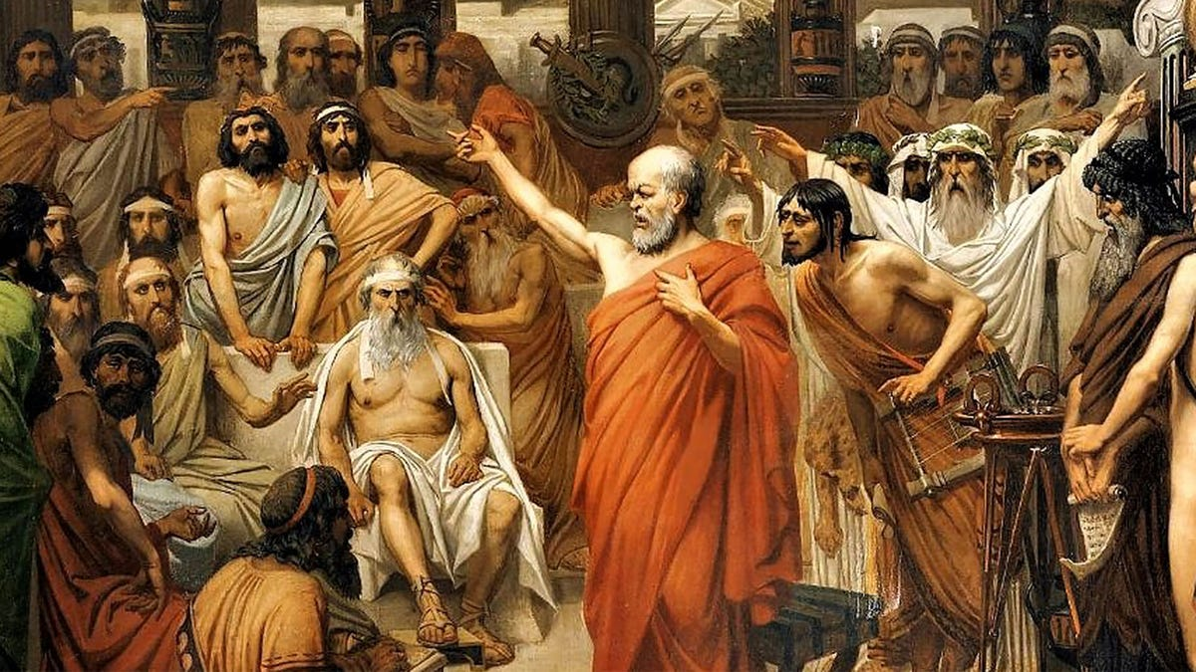
After the death sentence, the execution was postponed for 30 days.
During the 30 days, Socrates, as usual, visited his friends to discuss philosophical issues，just like usual.

Slide 10
3
Act
Farewell ！

Slide 11
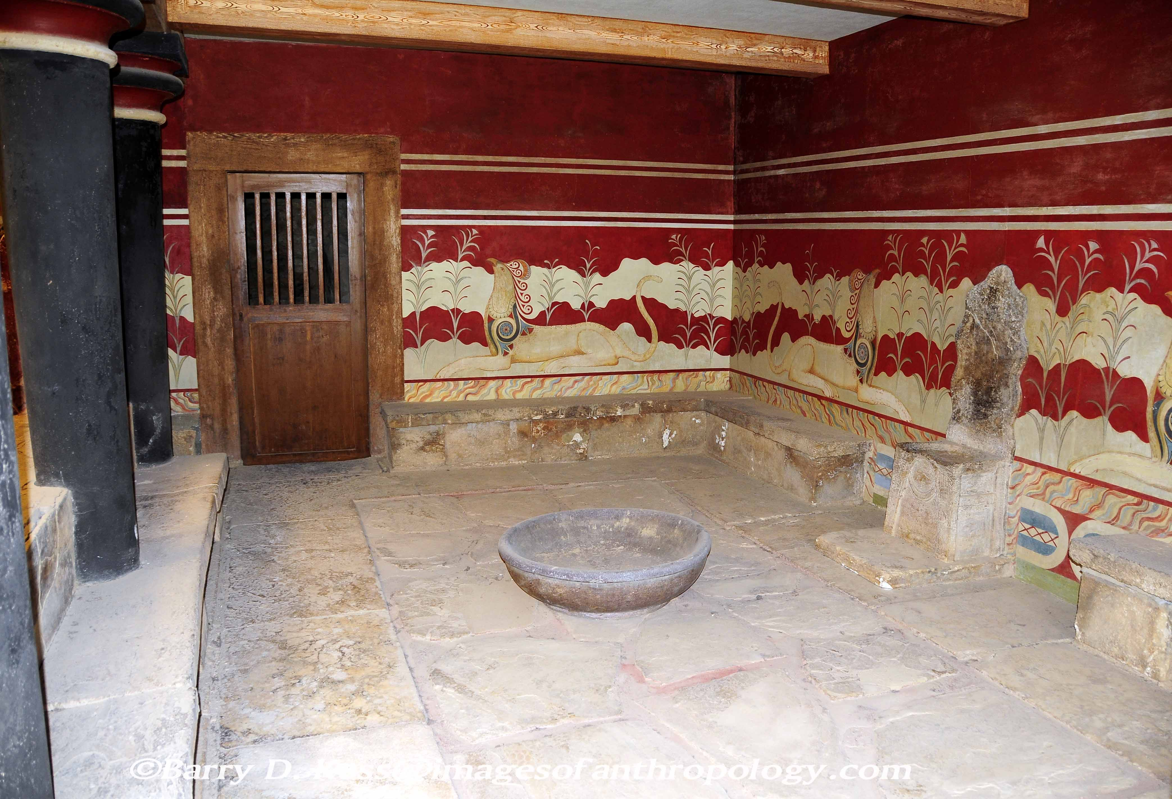

Slide 12
Only when the law has established its authority can there be national order and social justice!

Slide 13

Finally, the day of execution arrives......

Slide 14
4
Act
The Death of Socrates

Slide 16
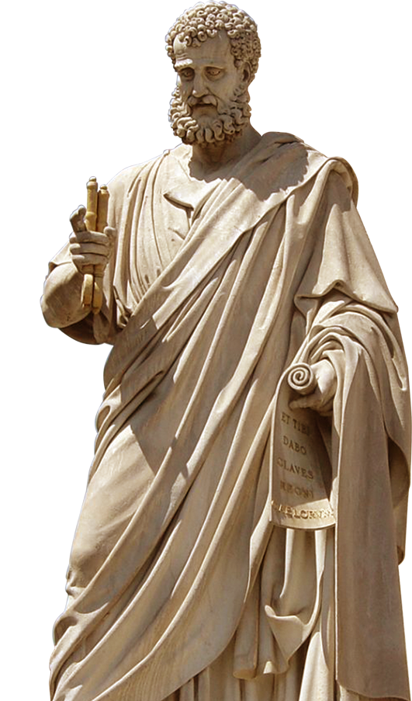
Thanks for listening!

